Slide 1
Cell Modeling: Harmonizing Representation
Across Foundry Ontologies
1. Proposed Changes to High Level CL Organization
Extensions for ReO/OBI
Defining key concepts: ‘experimentally modified’’

Slide 2
Updating CL Top Level Structure

Slide 3
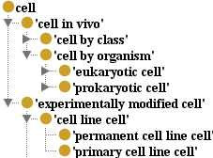
Updating CL Top Level Structure
Previous Structure
Issues to Address:
Consideration of unicellular organism cell types (no such thing as a prokaryotic cell in vivo)
Lack of principled classification of ‘cell’ into disjoint classes that exhaustively partition the domain (‘cell in vivo’ vs ‘exp mod cell)
Minor issues with chosen labels
Lack of definitions for top level classes

Slide 4
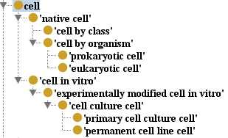
Updating CL Top Level Structure
Previous Structure
Issues to Address:
Consideration of unicellular organism cell types (no such thing as a prokaryotic cell in vivo)
Lack of principled classification of ‘cell’ into disjoint classes that exhaustively partition the domain (‘cell in vivo’ vs ‘exp mod cell)
Minor issues with chosen labels
Lack of definitions for top level classes
Updated Structure
Changes:
Changed label of cell in vivo to ‘native cell’, defined accordingly
Introduced ‘cell in vitro’ class as top level sibling for ‘native cell’
Fixed label issues
Gave all classes textual definitions

Slide 5
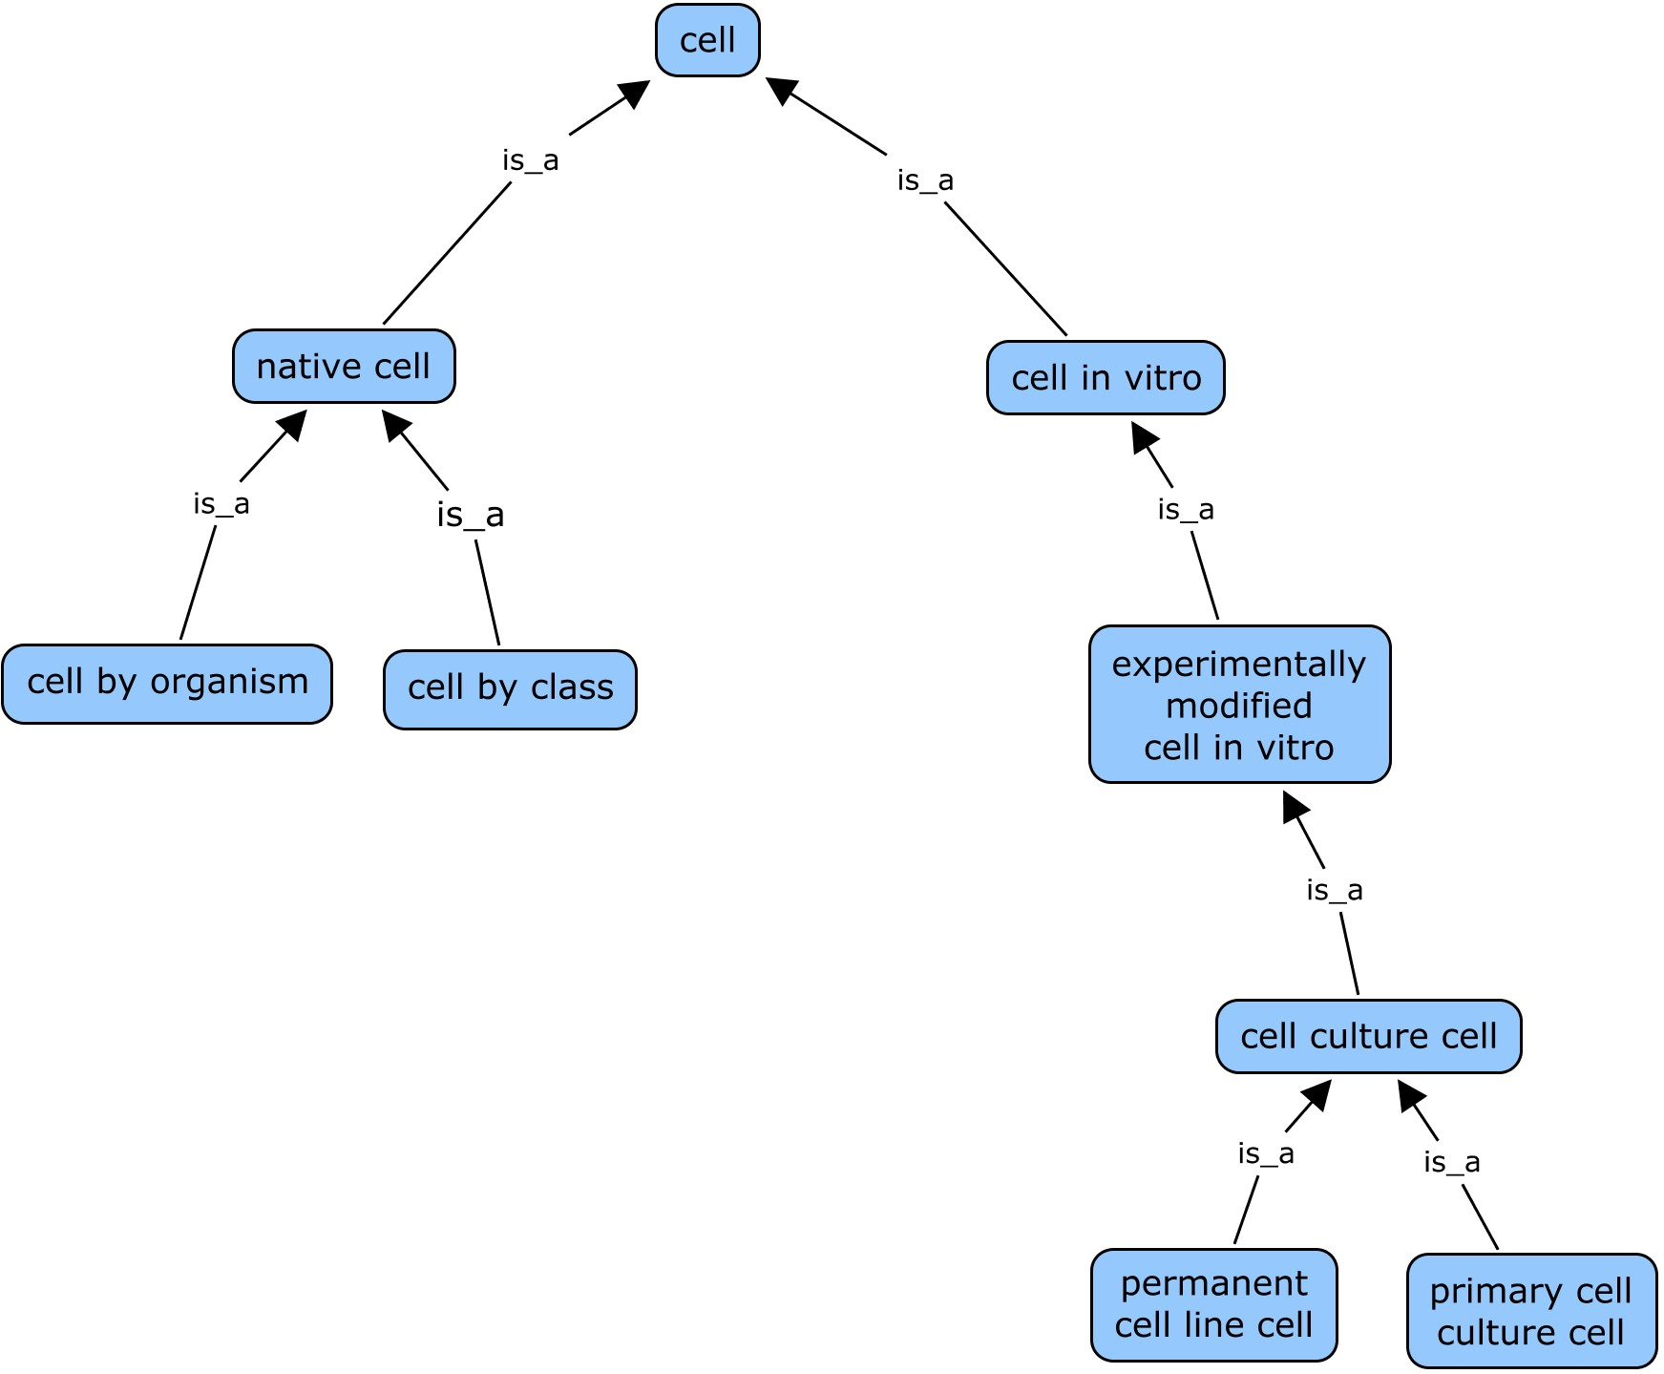
Updating CL Top Level Structure
placement in controlled
environment for study
structural
processing/modification
culturing

Slide 6
Updating CL Top Level Structure: Change Summary
cell: genus of definition changed from ‘anatomical structure’ to ‘material entity of anatomical origin’ (to reflect the fact that a CL:cell includes those removed from an organism).
cell in vivo: class relabeled as ‘native cell’, to account for unicellular organism cells in their natural environment, and defined as “a cell that is found in a natural setting, including multicellular organism cells ‘in vivo’ (ie part of an organism), and unicellular organisms ‘in environment’ (ie part of a natural environment).”
New class ‘cell in vitro’: added new class ‘cell in vitro’ as sibling to ‘native cell’ (‘native cell’ and ‘cell in vitro’ are disjoint), defined as “a cell that has been removed from a natural environment, and placed in a controlled artificial setting for use in some investigation or study. Includes multicellular organism cells removed from an organism, and unicellular organisms removed from a natural environment.”
experimentally modified cell: changed label of ‘experimentally modified cell’ to include ‘in vitro’ suffix (and changed definition to clarify that this class refers only to experimentally modified cells in vitro: “a cell in vitro that has undergone physical changes as a consequence of a deliberate and specific experimental procedure”
cell line cell: changed label of ‘cell line cell’ to ‘cell culture cell’ (‘culture’ being more general than ‘line’), and defined as “an experimentally modified cell that is propagated as part of a cell culture”
permanent cell line cell: added definition “a cell culture cell that is part of a cell line having the capacity to proliferate indefinitely if given appropriate space and nutrients”.
primary cell line cell: changed label to ‘primary cell culture cell’ (the word ‘line’ being reserved for immortalized cultures), and added definition “a cell culture cell that is part of a cell culture that does not have the capacity to proliferate indefinitely”.

Slide 7
Extending Updated CL in ReO/OBI

Slide 8
Extending Updated CL in ReO/OBI
CL hierarchy remains sparse, but implicit in
it are three dimensions for cell classification:
Context (native vs in vitro)
2. Experimental Status
(experimentally modified vs unmodified)
3. Organism of Origin
(prokaryotic vs eukaryotic?)
Many useful classes defined by these axes are not implemented in CL
e.g. no coverage of in vivo experimental cells
e.g. no treatment of multicellular organism cells vs unicellular organisms or breakdown of their related experimental cell types (i.e. cells ex vivo vs ex environment)
We have followed these dimensions to their logical conclusion, to flesh out a full hierarchy of cell types, which exhaustively partitions the domain to supply experimentally relevant classes for annotation of biomedical investigations

Slide 9
Extending Updated CL in ReO/OBI
CL hierarchy remains sparse, but implicit in
it are three dimensions for cell classification:
Context (native vs in vitro)
2. Experimental Status
(experimentally modified vs unmodified)
3. Organism of Origin
(prokaryotic vs eukaryotic?)
Approach:
Refine and define these dimensions to best fit our/community needs
(refine prok vs euk -> unicellular organism vs multicellular organism cell,
define ‘native’, ‘ex vivo’, ‘experimentally modified,’ )
2. Applied these classification axes in order used by CL, to facilitate ease of use
3. Implement these with logical definitions, and created equivalent classes that offer alternate views/application of these axes

Slide 10
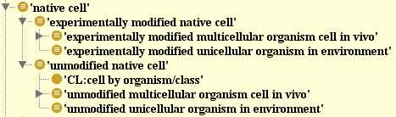
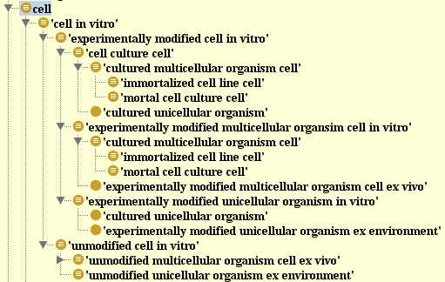
Refine/Define Axes and Apply
Dimensions for Classification
Context
native (in vivo/in environment) vs in vitro (in controlled setting/lab for study)
Experimental Status
experimentally modified vs unmodified* (save this discussion for later)
Organism
unicellular organism vs multicellular organism cell
The order of axes above best reflects what is in CL – but equivalent classes can be created to allow application of axes in any order (e.g to get a class of all cell culture cells (uni- or multi-cellular), or all multicellular organism cells)

Slide 11
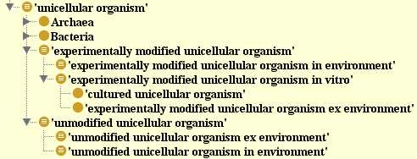
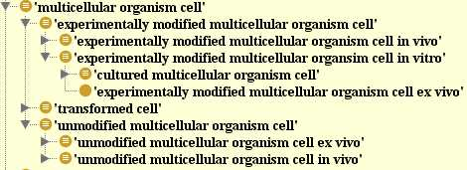
Refine/Define Axes and Apply
Dimensions for Classification : Alternate Order
1. Organism
unicellular organism vs multicellular organism cell
2. Experimental Status
experimentally modified vs unmodified* (save this discussion for later)
3. Context
native (in vivo/in environment) vs in vitro (in controlled setting/lab for study)
This alternate order would reflect a need for a class representing all multicellular organism cells vs all unicellular organisms.
notably, because all classes are logically defined, we get this full hierarchy automatically simply by creating the ‘unicellular organism’ and ‘multicellular organism cell’ defined classes

Slide 12
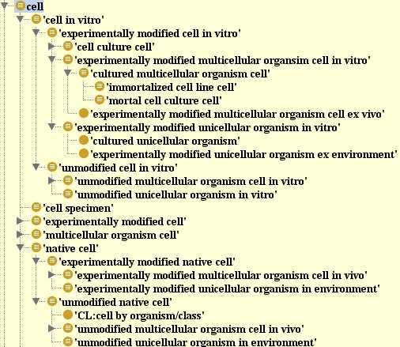
Mapping Between CL and ReO
Updated CL Hierarchy
Expanded ReO Hierarchy
*
* unclear if the CL class here refers only to cultured multicellular organism cells

Slide 13
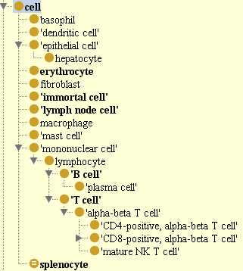
OBI Cell Hierarchy
‘cell’ class imported from CL
a handful of ‘cell in vivo’ subtypes imported form CL
additional in vitro/ experimental cell classes created in OBI (immortal cell, splenocyte, lymph node cell)
all seem to fit within proposed structure
OBI or ReO as potential home for extended modeling of CL classes?
Is the proposed ReO model compatible with what OBI needs?

Slide 14
What is ‘experimentally modified’, and why do we care?
Need a precise definition for this concept
note that it is applicable beyond cells
This concept matters to researchers
related to the expectation that a cell (or other entity) will function ‘normally’
this is important for scientists searching for or applying specimens/reagents, and important for interpreting data
What qualifies as an experimental modification?
we use the notion of contextual vs structural/physical processing objectives to answer this question
Role of objectives in classifying a material processing (must consider what is the specified output?) (see following examples of ‘reciprocal processes’)
example : ‘appendix removal’ as contextual vs physical material separation
example: ‘pathogen injection’ as contextual vs physical material combination
Notes:
- This concept that cells have or have not been experimentally matter to researchers
- related to the expectation that cells should function ‘normally’ (of course, removal from their biological context will affect their behavior, being cut off from external cues, but this cannot be helped) looking for and applying materials for their work, and interpreting experimental results.
Examples of reciprocal processes illustrate the notion that it is the objective and identity of the ‘specified’ output that can dictate if a given process represents a contextual or physical processing.
Role of perspective/objectives is key– a given material processing can represent either a contextual or structural processing (or both), depending on the researchers objective (which is indicated by the identity of the specified output)
- ex: a material separation such as appendix removal can be a structural processing it the specified output is a human without appendix, or a contextual processing if the specified output is an appendix that is now ex vivo.
- ex: a material combination such as injecting a pathogen into a lab rat can represent a structural processing if the specified output is the infected rat (ie goal is to study the rat’s response to pathogen), or a contextual processing if the specified output is the pathogen in the new context of the rat (ie the goal is to study the pathogen in the in vivo environment of a host)

Slide 15
Refine/Define Axes, Apply Order
What is ‘experimentally modified’, and why do we care?
material processing objective: an objective to create an specific output object from input materials. (via either a physical or contextual alteration)
physical processing objective: an objective for a material processing technique to yield a specified output wherein physical/structural changes have been made (ie material added or removed, and/or structural rearrangements made)
in ReO, this = (‘physical material separation objective’ or ‘physical material combination objective’)
contextual processing objective : an objective for a material processing technique to yield a specified output that has undergone a change in context or location, but to which no changes have been made affecting its inherent physical structure (ie no material added or removed, and/or structural rearrangements)
in ReO, this = (‘contextual material separation objective’ or ‘contextual material combination objective’)

Slide 17
Refine/Define Axes, Apply Order
What is ‘experimentally modified’, and why do we care?
physical material separation objective: an objective for a material separation technique to yield a specified output wherein physical/structural changes have been made (ie representing a modified version of s specified input material from which material was removed) . . . (aka material removal/decontamination objective?)
contextual material separation objective: : an objective for a material separation technique to yield a specified output that has undergone a change in context or location, but to which no physical/structural changes have been made (ie represents a new entity as opposed to a modified version of a specified input material, which remains unaltered in its internal/inherent/self-contained physical structure)
‘experimentally modified’ material is the specified output of a process that achieves a ‘physical processing objective’ (ie a physical material separation or combinatoin)
experimentally modified cell = cell and (is_specified_output_of some (‘material processing technique’ and (achieves_planned_objective some ‘physical processing objective’)))
so experimental modification is really the same as ‘physical modification’ in this model
Notes:
xxxx

Slide 18
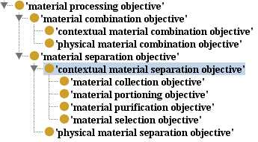
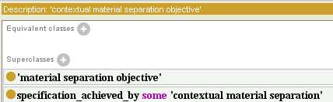
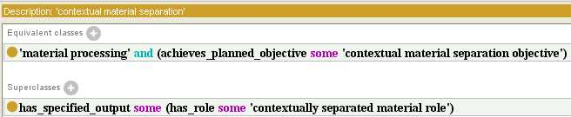
contextual material separation objective
contextual material separation
Notes:
xxxx

